Slide 1
Backpropagation neural net

Slide 2
3.1. standard backpropagation
Aplications using the backpropagation nets can be found in virtually every field that uses neural nets for problems that involve mapping a given set inputs to a specified set of target outputs (supervised training)

Slide 3
3.1. standard backpropagation…
As is the case with most neural networks, the aims is to train the net to achieve a balance between the ability to respond correctly to the input patterns that are used for training (memorization) and the ability to give reasonable (good) responses to input that is similar, but not identical, to that used in training (generalization)

Slide 4
3.1. standard backpropagation…
The training of a network by backpropagation involves 3 stages:
The feedforward of the input training pattern
The calculation and backpropagation of the associated error
The adjustment of the weight
After training, application of the net involves only the computation of the feedforward phase

Slide 5
3.1. standard backpropagation…
Even if training is slow, a trained net can produce its output very rapidly
Numerous variations of backpropagation have been developed to improve the speed of the training process
More than one hidden layer may be beneficial for some applications, but one hidden layer is sufficient

Slide 6
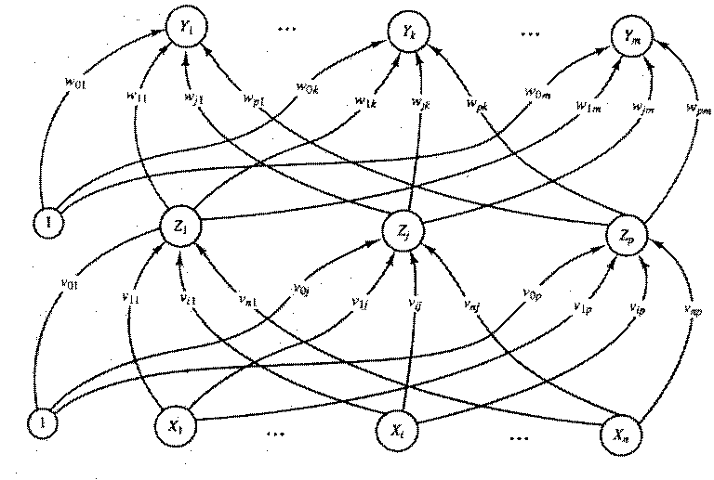
3.1.1 architecture

Slide 7
3.1.1 architecture…
A multilayer neural net with one layer of hidden units (the Z units)
The output units (the Y units) and the hidden units also may have biases
The bias on a typical output unit Y_{k} is denoted by w_{0k}
The bias on a typical hidden unit Z_{j} is denoted by v_{0j}
The bias terms act like weights on connections from units whose outputs is always 1
Only the direction of information flow for the feedforward phase of operation is shown

Slide 8
3.1.2 algorithm
The training of a network by backpropagation involves 3 stages:
The feedforward of the input training pattern
The calculation and backpropagation of the associated error
The adjustment of the weight

Slide 9
3.1.2 algorithm…
Data
X₁ | X₂ | X₃ | Kelas (target) t_{k}
12 | 11 | 7 | 1
15 | 10 | 60 | 2
15 | 11 | 34 | 2
20 | 13 | 24 | 1

Slide 10
3.1.2 algorithm…
The feedforward of the input training pattern
During feedforward, each input unit (X_{i} ) receives an input signal and broadcasts this signal (x_{i} ) to the each of the hidden units Z₁,…, Z_{p}
Each hidden unit (Z_{j} ) then computes its activation and sends its signal (z_{j} ) to each output unit
Each output unit (Y_{k} ) then computes its activation (y_{k} ) to form the response of the net for the given input pattern

Slide 11
3.1.2 algorithm…
The calculation and backpropagation of the associated error
During training, each output unit compares its computed activation (y_{k} ) with its target value t_{k} to determine the associated error for that pattern with that unit
Based on this error, the factor δ_{k} is computed for each output unit
δ_{k} is used to distribute the error at output unit Y_{k} back to all units in the hidden layer that are connected to Y_{k.}.
Its also use to update the weights between the output and the hidden layer
In a similar manner, the factor δ_{j} is computed for each hidden unit
It is used to update the weights between the hidden and the input layer

Slide 12
3.1.2 algorithm…
The adjustment of the weight
After all of the δ factor have been determined, the weights for all layers are adjusted simultaneously.
The adjusment to the weights (w_{jk} ) from hidden unit (Z_{j} ) to output unit (Y_{k}) is based on factor δ_{k} and the activation z_{j} of the hidden unit (Z_{j} )
The adjusment to the weights (v_{ij} ) from input unit (X_{i} ) to hidden unit (Z_{j}) is based on factor δ_{j} and the activation x_{i} of the input unit (x_{i} )

Slide 13
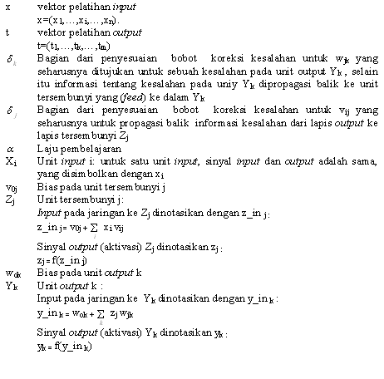
3.1.2 algorithm… Tata nama

Slide 14
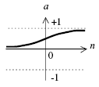
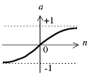
3.1.2 algorithm…
Activation function
Identitas
Sigmoid biner
Turunannya
Sigmoid bipolar
Turunannya

Slide 15
3.1.2 algorithm…Training algorithm
Langkah 0 : Inisialisasi nilai bobot dengan nilai acak yang kecil.
Langkah 1 : Selama kondisi berhenti masih tidak terpenuhi, laksanakan langkah 2 sampai 9.
Langkah 2 : Untuk tiap pasangan pelatihan, kerjakan langkah 3 sampai 8.

Slide 16
3.1.2 algorithm…training algorithm
Feedforward :
Langkah 3 : Untuk tiap unit input (Xi, i=1,…,n) menerima sinyal input xi dan menyebarkan sinyal itu keseluruh unit pada lapis atasnya (lapis tersembunyi)
Langkah 4 : Untuk tiap unit tersembunyi (Zj, j=1,…,p) dihitung nilai input dengan menggunakan nilai bobotnya :
Kemudian dihitung nilai output dengan menggunakan fungsi akti-vasi yang dipilih : zj = f ( z_inj )
Hasil fungsi tersebut dikirim ke semua unit pada lapis di atasnya

Slide 17
3.1.2 algorithm…training algorithm
Langkah 5 : Untuk tiap unit output (Yk, k=1,..,m) dihitung nilai input dengan menggunakan nilai bobot-nya :
Kemudian dihitung nilai output dengan menggunakan fungsi aktivasi :

Slide 18
3.1.2 algorithm…training algorithm
Backpropagation error
Langkah 6 :Untuk tiap unit output (Yk, k=1,..,m) menerima pola target yang bersesuaian dengan pola input, dan kemudian dihitung informasi kesalahan :
Kemudian dihitung koreksi nilai bobot yang kemudian akan digunakan untuk memperbaharui nilai bobot wjk. :

Slide 19
3.1.2 algorithm…training algorithm
Hitung koreksi nilai bias yang kemudian akan digunakan untuk memperbaharui nilai w0k :
dan kemudian nilai dikirim ke unit pada lapis sebelumnya.
Langkah 7 : Untuk tiap unit tersembunyi (Zj, j=1,…,p) dihitung delta input yang berasal dari unit pada lapis di atasnya :

Slide 20
3.1.2 algorithm…training algorithm
Kemudian nilai tersebut dikalikan dengan nilai turunan dari fungsi aktivasi untuk menghitung informasi kesalahan :
Hitung koreksi nilai bobot yang kemudian digunakan untuk memperbaharui nilai :
dan hitung nilai koreksi bias yang kemudian digunakan untuk memperbaharui :

Slide 21
3.1.2 algorithm…training algorithm
Memperbaharui nilai bobot dan bias
Langkah 8 : Tiap nilai bias dan bobot (j=0,…,p) pada unit output (Yk, k=1,…,m) diperbaharui :

Slide 22
3.1.2 algorithm…training algorithm
Langkah 9 : Menguji apakah kondisi berhenti sudah terpenuhi.
Kondisi berhenti ini terpenuhi jika nilai kesalahan yang dihasilkan lebih kecil dari nilai kesalahan referensi atau training telah mencapai epoh yang ditetapkan.

Slide 23
3.1.2 algorithm…aplication procedure
Step 0. initialize weights (from training algorithm).
Step 1. for each input vector , do steps 2-4.
step 2. for i=1,…,n; set activation of input unit x_{i};
step 3. for j =1,…,p:
zj = f ( z_inj )
step 4. for k= 1,…,m:

Slide 24
3.1.2 algorithm…choices
Choice of initial weights and biases
Random initialization (-0.5,0.5), (-1,1)
Nguyen-widrow initialization
How long to train the net
How many training pairs there should be
Data representation
Number of hidden layers & hidden nodes

Slide 25
3.2 contoh aplikasi… BPNN in Matlab
Examples
Here is a problem consisting of inputs P and targets T that we would like to solve with a network.
P = [0 1 2 3 4 5 6 7 8 9 10];
T = [0 1 2 3 4 3 2 1 2 3 4];

Slide 26
3.2 contoh aplikasi… BPNN in Matlab
Here a two-layer feed-forward network is created.
The network's input ranges from [0 to 10].
The first layer has five TANSIG neurons,
The second layer has one PURELIN neuron.
The TRAINLM network training function is to be used.
net = newff(P,T,5,{'tansig' 'purelin'},’traingd’);

Slide 27
3.2 contoh aplikasi… BPNN in Matlab
1
1
Z1
Z2
X1
Z3
Y1
Z4
Z5

Slide 28
3.2 contoh aplikasi… BPNN in Matlab
Here the network is simulated and its output plotted against the targets.
Y = sim(net,P);
plot(P,T,P,Y,'o')

Slide 29
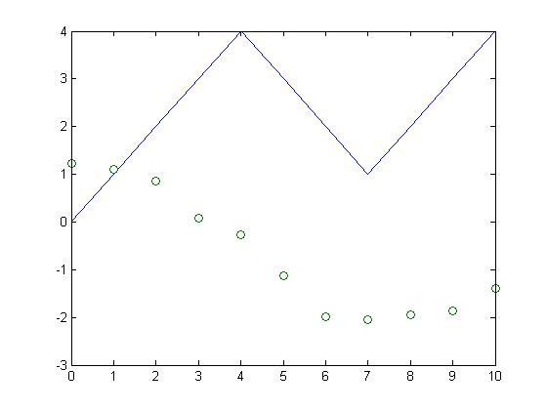
3.2 contoh aplikasi… BPNN in Matlab

Slide 30
3.2 contoh aplikasi… BPNN in Matlab
Here the network is trained for 50 epochs.
net.trainParam.epochs = 50;
net = train(net,P,T);

Slide 31
3.2 contoh aplikasi… BPNN in Matlab
>> net.trainParam.epochs = 50;
net = train(net,P,T);
TRAINLM, Epoch 0/50, MSE 12.7492/0, Gradient 78.4873/1e-010
TRAINLM, Epoch 25/50, MSE 0.0468381/0, Gradient 0.256482/1e-010
TRAINLM, Epoch 50/50, MSE 0.0262717/0, Gradient 20.0472/1e-010
TRAINLM, Maximum epoch reached, performance goal was not met.

Slide 32
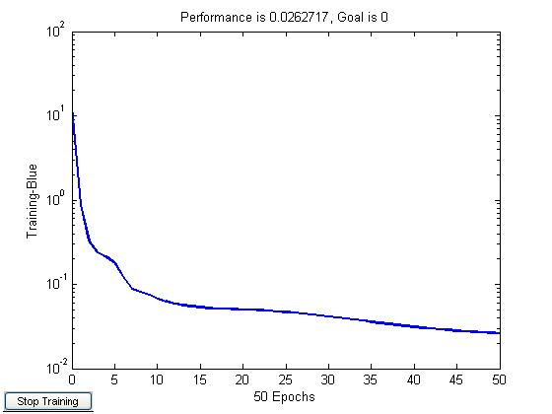
3.2 contoh aplikasi… BPNN in Matlab

Slide 33
3.2 contoh aplikasi… BPNN in Matlab
Again the network's output is plotted.
Y = sim(net,P);
plot(P,T,P,Y,'o')

Slide 34
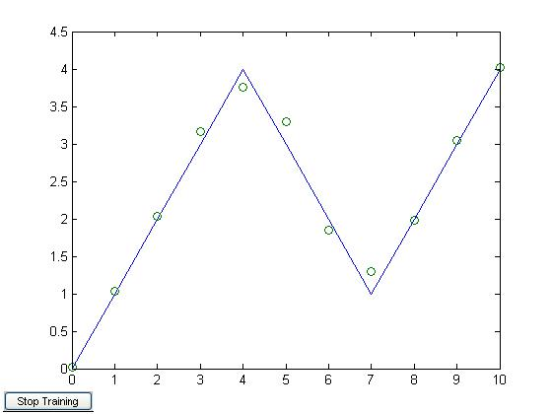
3.2 contoh aplikasi… BPNN in Matlab

Slide 35
Pustaka
Fausset L. 1994. Fundamental of neural Networks.

